Slide 1
People Counter
Notes:
Group 1 consists of 3 members, Idris(which is myself), Anders and Ahmad
Our project idea is to create a People Counter, which as the name implies, will count the number of people at a given location.
First, I’ll mention where this idea originated from, thereafter, what our goals for this project were, and lastly; what we achieved.

Slide 2

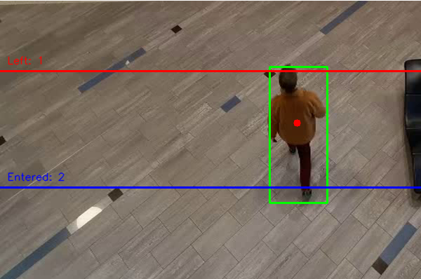
Project summary
Idea
Problem
We want to know how many people enter and leave a given location and keep a count of all the people currently there.
E.g., malls, stores, libraries, lecture halls, buildings, workplaces etc.
Goal(s)
We want our program to be reusable in many different use cases, to keep track of and count the number of visitors at any given location.
Achieved
Functioning program
Limitations
Reusable
Result
Notes:
This idea originates from the Covid restriction, especially with regards to the imposed restriction on the maximum amount of people at a given location.
To the right, there’s a poster which probably most of us have seen, Or a poster of a similar kind: where the maximum number of allowed people is stated. And it’s usually placed by the entrance of stores and other public facilities.
The problem with such restrictions, is that in most cases there’s nothing, or no one, to enforce it. When we go shopping for instance; we rarely see someone standing by the entrance keeping a track of the current visitors
Hence, what’s the use of a restriction, if there’s no one to enforce it?
This is the origin of our project idea.
Our end goal is to create a program reusable in a myriad of different use cases, where it will keep track of the number of people that enter, leave and are currently inside a given location.
Achievement: By working on this project throughout the semester, we have accomplished our goals and have successfully created a code which performs the aforementioned tasks.
Something to note however, is that there áre some slight limitations, -which we’ll elaborate later- but in its entirety, the project was a success, and we accomplished our goals.
[ On the lower right hand-side, you can see how the end results looks like ]

Slide 3
Challenges to solve
Recognize
Track
Count
Analyze
Notes:
There were of course many challenges to such a project, both big and small, but we have narrowed them down to 4 categories.
These are Recognizing, tracking, counting and lastly analyzing.
The first real challenge we were met with, was the problem of recognition.
Our code needed to be able to discern a human being from recordings, whether a live video feed, or a saved recording, and
this again had its own set of problems;
Such as randomly labelling objects as humans, or not being able to discern a human in certain positions, people blocking each other out of view etc.
Moving on, the second problem was tracking the people.
Once we’ve recognized a person, we needed to track their position at all times, and this again had its own challenges, where it would often either lose track of a person or not recognize him altogether, due to the former problem ofc.
The third challenge was to define a system of what counts as entering and leaving.
Whenever a person entered or left, it needed respectively add or substract to the variables, and update the current visitors.
Lastly, we had to analyze the data.
This includes representing our data, but in addition to that -although it’s partly outside of the scope of this project- you can generate statistical data.
This goes hand in hand with our project goals of reusability and being apply to apply our code in many different use cases.
With the way we have constructed the code, you are able to for instance: generate statistical data such as creating a histogram or a graph of how many customers there are at what times during the day and so on.
Moving on, Anders will elaborate on the use cases of our project.

Slide 4
Use cases
Our program will be applicable many different scenarios and settings/locations such as:
Shopping centers, stores, libraries, lecture halls, buildings, workplaces etc.
Applicable to both live video-feed and recordings.
Use cases may be as follows:
Counting the number of shoppers at store where there’s a Covid-restriction.
Statistical data of visitors at public facilities.
During emergencies, knowing the amount of people inside a building etc.
Notes:
Use cases: See slide
Statistical analysis:
At what time of day, on which days of the week are there more shoppers.
How many actually purchase something and how many just look. Compare to transactions completed

Slide 5
Problem solution
Recognize
Separate the moving object from the static background
Track
Every object gets a direction based on the first detection coordinate.
Count
Two borders
Analyze
Live information windows showing number of current visitors and max number of visitor both with time
Binarization and filtering
Detection
Object direction
Object state
Object centre point movement each frame
Graph shows the number of visitors in relation to time
Notes:
To recognize an object, we separate the moving object from the background which should be static.
After that we binarize and filtering every frame in video to make a clear black white images, so we can use a detection function on them.

Slide 6
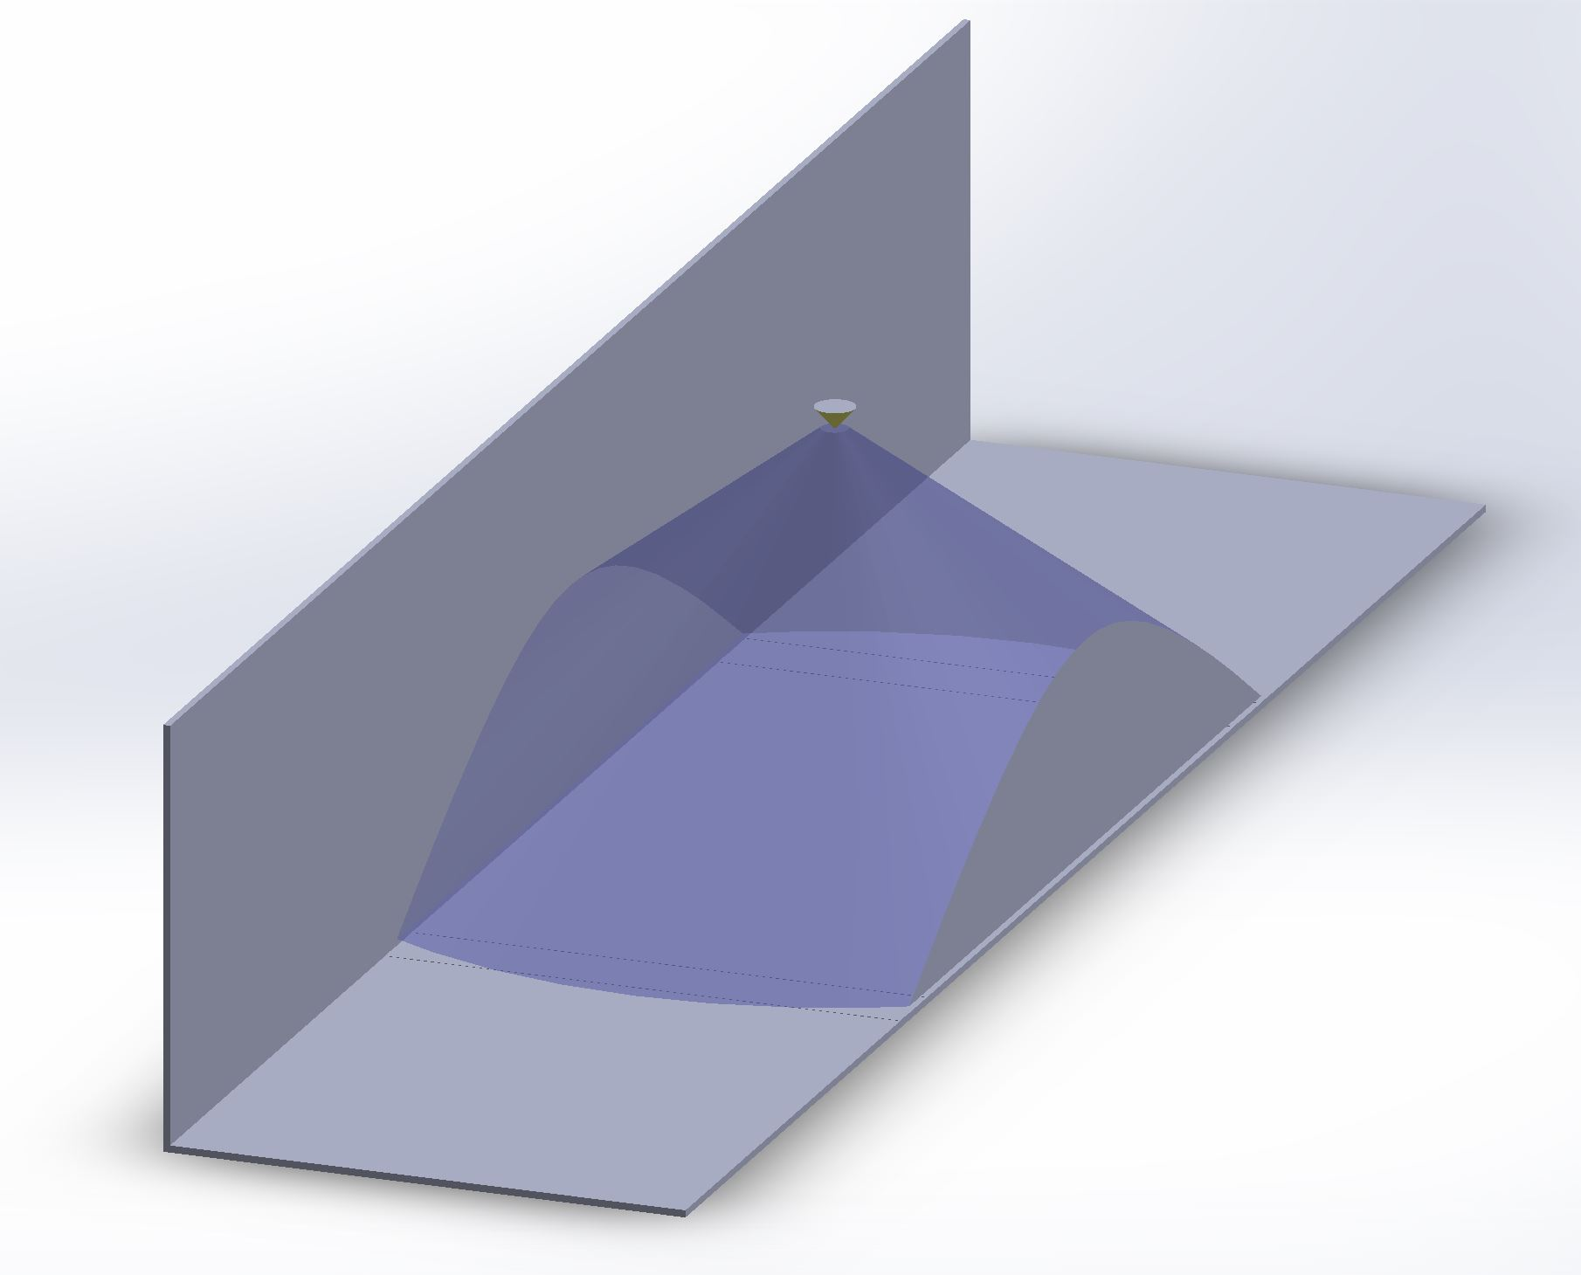

Dataset & data collection
Notes:
Our Dataset is a Video (clip og live)
The camera should be placed like figure on the left. so we can get every person separately figure on the right. Other ways could a person get behind another one.

Slide 7
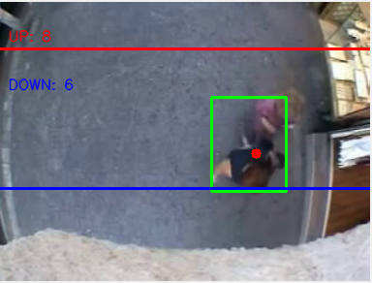
Results and Conclusion
Detects moving objects
Counts the objects detected
Learning outcomes
Limitations:
Does not distinguish between objects, animals, people.
Notes:
We have managed to develop a program that is not only using people detection, but detects moving objects in general.
This has turned out to be both a weakness and a strength, especially considering the possibilities connected to further development. It could be used in traffic – counting cars to detect rush hour, or for use in statistics. It could be used to count the number of bikes that pass a certain area each day, and so on.
Lært mye om hvordan bruke OpenCV.
The limitations of the project are then connected to this last statement. That the algorithm does not specifically detect people, but detects moving objects based on the percentage of the screen the object occupies. This way, depending on the calibration of the code done to suit each video stream, the algorithm might not detect a child, it might detect a large dog as a person, or not be able to distinguish two people walking closely together, which is the case in our example video.

